Slide 1
Infrastructure Capacity Tests in Stress Scenarios – Post-Trade Environment
WEBINAR
Nov. 8, 2022

Slide 2




Purpose of the Webinar
  To present participants with the indicators and work plan related to technology capacity management for the post-trade environment in the Listed B3 market
Presentation of the regulatory framework related to infrastructure capacity
Establishment of the capacity indicators to be used in tests, as well as the metrics considered
Support, guidance and assessment of the capacity tests in stress scenarios

Slide 3
Presentation of the regulatory framework related to infrastructure capacity
Establishment of the capacity indicators to be used in tests, as well as the metrics considered
Support, guidance and assessment of the capacity tests in stress scenarios

Slide 4

CVM Resolution 35/2021 – Regulatory framework regarding infrastructure capacity in stress scenarios
Art. 2 For the purposes of this Resolution, it is considered:
XIV – critical business processes
XV – relevant services
XVI – critical systems
Art. 33. The broker shall:
Paragraph 1 The information technology structure shall be compatible with the volume, nature and complexity of its operations (...).
Paragraph 3 The technological systems used by the broker shall be:
II – (...) tested at an appropriate frequency to verify its operation in stress scenarios.
Art. 38. The broker shall implement and maintain :
I – business impact analysis process to (...):
identify and classify critical business processes
Art. 39. Critical systems are all the computers, networks, and electronic and technological systems
Art. 40. The broker shall:
I – develop and implement policies and practices to ensure the integrity, safety, and availability of its critical systems
  Aug/2019: CVM Instruction 612 published
  Sep/2020: CVM Instruction 612 and related circulars
  came into effect
  May/2021: CVM Resolution 35 published
  PQO Basic Script

Slide 5
CVM Resolution 35/2021 – Regulatory framework regarding infrastructure capacity in stress scenarios
Chapter II – DEFINITIONS
Art. 2 For the purposes of this Resolution, it is considered:
XIV – critical business processes: processes and operational activities whose unscheduled interruption or unavailability may have a significant negative impact on the broker's business, subject to the provisions of paragraph 1 of art. 38
XV – relevant services: services related to critical business processes pursuant to art. 38
XVI – critical systems: term defined in art. 39
Chapter X – RULES OF CONDUCT
Section I – Duties of the Brokers
Art. 33. The broker shall:
Paragraph 1 The information technology structure shall be compatible with the volume, nature, and complexity of its operations, in order to preserve customer service even in periods of peak demand.
Paragraph 3 The technological systems used by the broker shall be:
II – submitted to tests at appropriate intervals, established in the policy pursuant to art. 41, to verify its operation in stress scenarios.

Slide 6
CVM Resolution 35/2021 – Regulatory framework regarding infrastructure capacity in stress scenarios
Chapter XI – BUSINESS CONTINUITY PLAN
Section I – General Rules
Art. 38. The broker shall implement and maintain:
I – business impact analysis process to:
a) identify and classify critical business processes
b) evaluate the potential effects of the interruption of critical business processes on its activities
Paragraph 1 In addition to other processes considered critical by the broker under item I, business continuity plans shall cover at least the following processes, if applicable to the broker:
II – settlement with the entities managing organized markets
III – liquidation of its customers
IV – reconciliation and updating of the positions of its customers.
Chapter XI – BUSINESS CONTINUITY PLAN
Section II – Critical Systems
Art. 39. Critical systems are all computers, networks and electronic and technological systems that are linked to critical business processes and that directly execute or indirectly provide support to functionalities, whose malfunction or unavailability can have a significant impact on the broker’s business.
Art. 40. The broker shall:
I – develop and implement policies and practices to ensure the integrity, safety and availability of its critical systems
II – establish guidelines for assessing the relevance of incidents

Slide 7
CVM Resolution 35/2021 – Regulatory framework regarding infrastructure capacity in stress scenarios
  Aug/2019: CVM Instruction 612 published
  Sep/2020: CVM Instruction 612 and related circulars
  came into effect
  May/2021: CVM Resolution 35 published
  PQO Basic Script
The PQO Basic Script is a condition for Participants to access B3’s markets. Its items 131 and 138 respectively define the Participant’s obligations regarding:
(a) execution of periodic (annual) capacity tests of its infrastructure in stress scenarios
(b) implementation and execution of business continuity plan tests, within a maximum interval of one year, in a scenario of interruption to its critical business processes, which include minimal processes such as liquidation with clients and B3

Slide 8
Presentation of the regulatory framework related to infrastructure capacity
Establishment of the capacity indicators to be used in tests, as well as the metrics considered
Support, guidance and assessment of the capacity tests in stress scenarios

Slide 9
Indicators
Conception
  A Capacity Working Group was created, composed of the participants of the Advisory Committee to establish the scope, capacity indicators and follow-up of activities
  B3 set out a series of premisses and a list of indicators, among which six were selected for mandatory execution
Indicators
  Are the metrics used to assess the performance of the systems, seeking to pre-empt any problems that might impact post-trade processes, contemplating liquidation, custody, risk management and registration activities
Scope
  Post-trade infrastructure and processes, including:
    Capture, give-up, allocation, position control, securities lending and liquidation
    Custody and processing of corporate actions
    Risk, margin calculation, mocks, risk assessment for position and collateral changes and margin call
    Registration processes, such as the creation and maintenance of accounts
Premisses
  Minimum frequency of tests: annual;
  Criterion: Peak volume observed at each institution (since Jan/2020) + increment defined by the participant
  Participants must construct/use their environments and their injectors/mocks together with their suppliers
  Participants must monitor the indicators and establish a business continuity program to assure provision in cases with higher volume than those tested

Slide 10
Mandatory Indicators
Indicators
PNP*
PL*
ACST*
Trades Captured on one day
X
X
X
Capacity to receive a capture message (PNP/ACST- bvmf.012 or PL - bvmf.019) and process the trade capture in its application
Trades allocated on one day
X
X
Capacity to allocate trades via message (bvmf.013) and process the confirmation message (bvmf.014)
Accepted/rejected give-ups on one day
X
X
Capacity to accept/reject give-ups via message (bvmf.016) and to process the confirmation message (bvmf.014)
Processing of Conciliation files on one day
X
X
X
Capacity to process the conciliation files (BVBG.012, BVBG.013, BVBG.014 or BVBG.081) requested by the bvmf.018 or bvmf.186 messages
Lending contracted on one day
Capacity to request the completion of a securities lending pre-agreement or transaction through the bvmf.127 message and to process the
X
X
confirmation message (bvmf.128, bvmf.192 or bvmf.193)
Early liquidation of securities lending agreement on one day
Capacity to request (bvmf.131) the early settlement of a securities lending agreement, to process its partial status receipt (bvmf.133) and
X
X
X
to process confirmation of the request (bvmf.192)
*PNP – Full Trading Participant / PL – Trading Participant / ACST – Custody Agent

Slide 11
Mandatory Indicators - Details
Trades Captured on one day:
Measurement Point
Injector/
Mock
Application
bvmf.012 (PNP/ACST)
bvmf.019 (PL)
PNP/PL/ACST

Slide 12
Mandatory Indicators - Details
Trades allocated on one day:
Measurement Points
Injector/
Mock
Application
bvmf.013
bvmf.014
PNP/PL

Slide 13
Mandatory Indicators - Details
Give-ups accepted/rejected on one day:
Measurement Points
Injector/
Mock
Application
bvmf.016
bvmf.014
PNP/PL

Slide 14
Mandatory Indicators - Details
Conciliation file processing in one day:
Measurement Points
bvmf.186
Injector/
Mock
Application
BVBG.086 (PNP/PL)
bvmf.018
BVBG.012 (PNP/ACST)
bvmf.018
BVBG.013 (PNP/PL/ACST)
bvmf.018
BVBG.014 (PNP)
PNP/PL/ACST

Slide 15
Mandatory Indicators - Details
Lending contracted in one day:
Measurement Points
Injector/
Mock
Application
bvmf.127
bvmf.128
bvmf.192/193
PNP/PL

Slide 16
Mandatory Indicators - Details
Early settlement of securities lending agreements in one day:
Measurement Points
Injector/
Mock
Application
bvmf.131
bvmf.133
bvmf.133
bvmf.192
PNP/PL/ACST

Slide 17
Non-Mandatory Indicators
Participants will execute non-mandatory indicators as required and shall follow the premisses mentioned previously
Indicators
Maximum number of open positions (futures, options, forwards and securities lending)
Maximum number of covering/shorting actions
Maximum number of cash liquidation entries (BVBG.021 treatment)
Maximum number of position and collateral transfers
Maximum number of asset transfers in the day
Maximum number custody positions (processing of end of day balance file)
Maximum number of corporate action transfers in the day
Maximum number corporate action positions (events file processing at the end of the day)
Number of risk consultations in the day (request and response)
Number of mocks held requiring risk assessment, per subaccount, in the day
Maximum number of different assets in collateral (to assess participants’ inventory and processing)
Measurement of the maximum number of collateral transfer messages (deposit, withdrawal, distribution and transfer)
Measurement of the maximum number of simultaneous consultations (collateral deposited, margin call and collateral transfer)
Volume of accounts created per hour
Volume of links created per hour
Number of live accounts in the base of their systems (inventory)

Slide 18
Indicators – Results Statement
The results must be communicated via the appropriate form (to be sent out at the start of 2023)
The report must contain the following information:
  Name of the application
  Version
  Supplier
  Test Environment
  Hosting of the Test Environment
  Technical data of the Test and Production environment
  Architecture of the environments
  For each indicator
    Peak Data of information (Data and qty);
    % of Increment and Rational
    Quantity executed
    Conclusion of the Result
      If unsatisfactory: Plan of Action, Deadline and Responsible Party

Slide 19

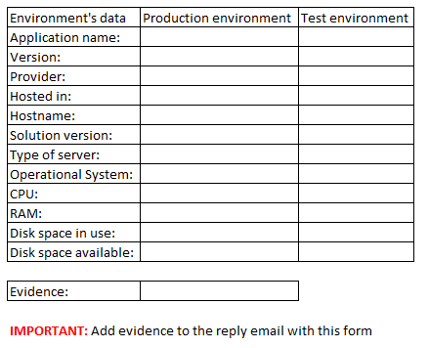
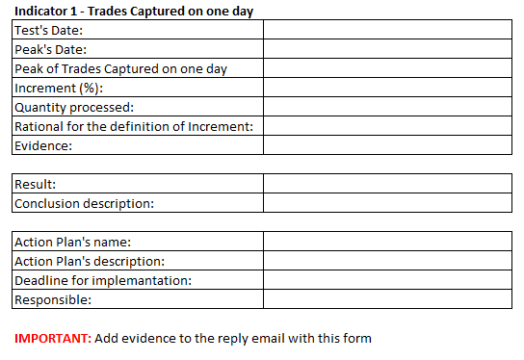
Indicator - Results
Example

Slide 20
Presentation of the regulatory framework related to infrastructure capacity
Establishment of the capacity indicators to be used in tests, as well as the metrics considered
Support, guidance and assessment of the capacity tests in stress scenarios

Slide 21
Support, Guidance and Assessment
Next Steps
2022 / 2023: Support and Guidance for Participants in the Capacity Tests
        (Guidance Webinar; and Publication of the Report Model to be used)
2023: Performance of Post-Trade Capacity Tests by the Market (until Dec. 30, 2023)
    Planning indicators for 2024
1st quarter of 2024: BSM Assessment
(Audit of the Capacity Tests performed in 2023)
2024: Assessment of the Market Result, for planning the next Capacity Tests

Slide 22

Any questions?

Slide 23
References
Messaging Catalog:
http://www.bvmfnet.com.br/pt-br/manuais/clearing-bmfbovespa/catalogo-de-mensagens-e-arquivos.aspx?idioma=pt-br#a
Technical queries:
liquidacao.certifica@b3.com.br
Auditing queries:
auditoria@bsmsupervisao.com.br

